Slide 1
React – Level 1
Introduction
Revised: August 18th 2019

Slide 2

What is React?
Created and maintained by Facebook
Was open-sourced in 2013 (Core team still at FB)
A JavaScript library for building user interfaces
Library, not framework
Declarative, not imperative
Favors composition over inheritance
Component-Based
Well-suited for Single Page Applications (SPAs), BUT…
Well-suited for not SPAs too!

Slide 3
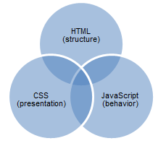
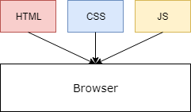
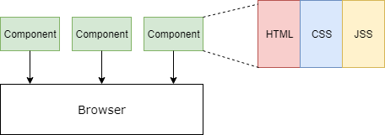
React Design Philosophy
React presents a different way to reason about separation of concerns

Slide 4
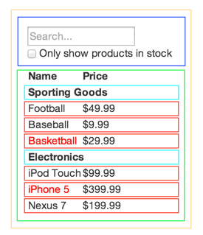
Composition
What if instead of separating functional, role-based concerns we separated concerns from the perspective of composition?
<FilterableProductTable>
<SearchBar />
<ProductTable>
<ProductCategoryRow />
<ProductRow />
<ProductRow />
<ProductRow />
</ProductTable>
</FilterableProductTable>
Notes:
Each of these components can carry semantics, style, functionality, and state. One criticism is that Html, JS, and Style are tightly coupled in React. This is usually true, particularly if you embrace React design principles. We’ve been told to make sure to keep them far from each other. Why? One reason is that separating these things makes it clear where we should go when we need to fix or change something… But so do components. Want to fix or change the Calendar? Go to the calendar component. The page is broken down into composable, reusable components. When you’re designing one, you don’t have to worry about the complexity of the others. Build that one component well and be done with it. It is a different way of thinking than the old conventions… Conventions that were established when SPAs and JavaScript Frameworks were not the norm. If bucking convention bugs you, you’ll need to get over it. React does this kind of thing. The new suspense API throws a promise if the component or value cannot yet be returned. We’ve been told that using throws in normal execution is bad!!! But why? There’s no technical reason not to.

Slide 5
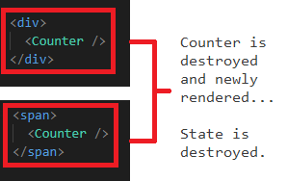
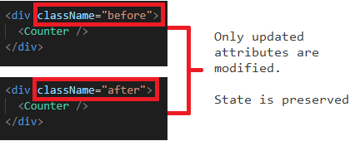
How Does React Work?
React’s render() function creates a representation (not quite the same as a copy) of the DOM tree (Virtual DOM)
An update to state or props occurs and render() returns a rebuilt Virtual DOM tree
React diffs the trees and only updates the DOM elements that have changed
Elements of Different Types:
Elements of the Same Type:

Slide 6
React Elements
React elements are plain objects that are light, stateless, immutable representations of DOM nodes or other components.
Element factory takes three arguments: React.createElement(type, [props], [...children])
type: string representing a DOM element (e.g., ‘div’ ) or a Component, which returns a React element or another Component… and so on until an element representing a primitive DOM element is encountered.
props: Single value or an object containing a set of values passed into React Components. The naming convention in JSX is similar to HTML attributes: <Greeting name=‘Jeff’ /> or React.createElement(Greeting, { name=‘Jeff’ }, null);
children: Think children in an HTML sense. This can be text (to be included inside of the tags), or other React elements. These will be appended to props so they will be accessible from inside the component as props.children
Remember, you won’t use React.createElement - JSX will do this behind the scenes!

Slide 7
React Elements
React elements are object representations.
This is why manipulating the Virtual DOM is so cheap.
Our first JSX example:
Results in an object similar to this:
<div className="greeting">
<h1>Hello, world!</h1>
</div>
{
"type": "div",
"props": {
"className": "greeting",
"children": {
"type": "h1",
"props": {
"children": "Hello, world!"
}
}
}
}
Which is compiled to this JS:
React.createElement(
'div',
{className: 'greeting'},
React.createElement(
'h1',
null,
'Hello, world!'));

Slide 8
React Components
In addition to elements that represent DOM nodes, there can be elements that represent user defined React Components. A React Component is a function or class that takes an optional object parameter we call “props” and returns an element.
const HelloWorld = (props) => {
return <h1>Hello World;</h1>
}

Slide 9
JSX IS JavaScript
JSX
Not HTML, just looks like it
Syntactic sugar for React.createElement()
Similar to document.createElement() but makes React element
After diffing and reconciliation, ultimately uses document.createElement() behind the scenes to create DOM elements
Transpiled by build tool (e.g., Babel)
className and htmlFor replace class and for attributes (there are others)
const element = (
<div className="greeting">
<h1>
Hello, world!
</h1>
</div>
);
JavaScript Equivalent
const element = React.createElement(
'div',
{className: 'greeting'},
React.createElement(
'h1',
null,
'Hello, world!'));
Notes:
This slide will introduce JSX (syntactic sugar) and show the React.createElement syntax that the JSX is being transpiled to. A relationship should also be made between vanilla JS document.createElement functions. Discuss how this is actually what’s happening behind the scenes because at it’s core, no matter what libraries are used we can only use the dom’s api at the browser level

Slide 10
JavaScript IN JSX
We can even use JavaScript from within JSX using curly braces.
colors = ['green', 'red', 'blue', 'orange'];
render() {
return (
<ul>
{colors.map(color => (
<li> {color} </li>
))}
</ul>
);
}

Slide 11
ReactDOM
ReactDOM manages the reconciliation of React elements and the DOM.
ReactDOM.render() is the “entry point” into the HTML document.
The render method takes a React element and a container DOM node.
There could be one entry-point – usually the case in a Single-Page Application (SPA) – or many entry points, effectively making a bunch of little React apps.
<div id='root'>ReactDOM will mount it's element here</div>
ReactDOM.render(<h1>Hello World! from ReactDOM example</h1>, document.getElementById('root'));

Slide 12
Next:
ReactDOM and JSX in code.

Slide 13
References and Credits
Maximilian Schwarzmüller – https://www.udemy.com/react-the-complete-guide-incl-redux/learn/v4/overview
Max is an awesome instructor. If he teaches it and it’s on sale at Udemy I buy it. Even stuff I’m not trying to learn at the moment
FreeCodeCamp – I ripped off a couple of images
Tyler McGinnis - https://tylermcginnis.com/free-react-bootcamp/
Some content, overall flow, and some of the example project inspiration
Reactjs.org – Really thoughtful, well put together documentation.

